Slide 1
Elements of Categorial Logic
Mirko Farina
Assistant Professor
Innopolis University
* I do not claim authorship for all texts and pictures in the presentation.

Slide 2
Historical Overview (Aristotle and the Stoics)
What is Categorical Logic?
Propositions OR Statements
Elements of Categorical Logic
-(subject/predicate terms; copulas; quantifiers)
5. Exercises on Diagramming
2

Slide 3
Historical Overview (Aristotle and the Stoics)
Aristotle forefather of Modern Logic
Aristotelian Logic is known as Syllogistic, Categorical or Term Logic
Aristotle’s theory of Syllogism has had unparalleled influence in Western thought
3

Slide 4
Aristotle’s work on Logic is rich and complex
- Included in the Organon
Consists of several treatises, among them:
Categories
Prior and Posterior Analytics (+)
Topic
On the Interpretation
Sophistical Refutations (+)
4

Slide 5
Aristotelian Logic is based on Deductive Reasoning
AND that is grounded on two ideas/notions or pillars:
Syllogism (argument with exactly 2 premises)
264, Medieval tradition with Boetius, Abelard, Buridano
Terms (atonimc units denoting classes/categories of things)
5

Slide 6
BIG ISSUE:
Underlying Aristotle’s magnificent work in Logic there is a deep question
IS LOGIC PART OF PHILOSOPHY (Stoics) OR IS IT A MERE TOOL (Aristotle)?
Aristotle thought that logic should be used to guide metaphysics. Logic was the cornerstone of knowledge, a tool to investigate basic truths.
The Stoics disagreed, they thought that doing logic meant doing philosophy
6

Slide 7
The Stoics were a very influential and powerful school of thought which spanned several centuries from the Greek time to the Roman
KEY concepts: ataraxia and virtues -> (virtue ethics)
KEY Proponents: Zeno, Crisippus, Seneca, Marcus Aurelio
7

Slide 8
STOICS: Important Contributions to Logic
Crisippus / Aristotle rivalry
Difference: Stoic logic was based on the analysis of propositions rather than terms
Much praised by modern logicians but largely forgotten because crucial works have been lost
8

Slide 9
The Fundamental Logical notion (atomic) for the Stoics was not that of term but rather that of Assertible (the content of a statement)
Example: it is night, it is raining this afternoon
9

Slide 10
Atomic Units (Assertibles’) can be enriched and expanded via connectives (as in propositional logic)
Conditional (if)
Conjunctive (and)
Disjunctive (or)
EASY TO SEE WHY STOIC LOGIC IS VALUED IN MODERN TERMS … WE WILL TALK ABOUT THIS LATER ON IN THE COURSE
10

Slide 11
2. What is Categorical Logic?
A fairly simple logic of categories or classes
In this logic, we can say something about all members of a class, called a universal sentence, or we can say something about some members of a class, called a particular sentence. We can also make a positive claim, called an affirmation, or we can make a negative claim, called a negation
11

Slide 12
Categorical logic is the logic that deals with the logical relationship between categorical propositions.
A categorical proposition is simply a proposition about a category or type of thing.
12

Slide 13



In categorical logic, important logical terms are the terms “all” and “some.”
In categorical logic we will use capital letters to stand for categories of things in the world, We can represent the statement:
All humans are mortal
as
All H are M
where “H” stands for the category of “humans” and “M” stands for the category, “things that are mortal.” Notice that the categories are nouns or noun phrases.
13

Slide 14
3. Propositions OR Statements (a philosophical distinction…)
Propositions (declarative sentences, meaning of a sentence):
- assertion about categories or classes*; makes two claims; possess a truth value
* What is a class?
Anything abstract that has concepts or members in it
Statements (descriptive sentences)
Linguistic objects, Express propositions, Do not have truth values
a statement is "true" in virtue of the proposition it expresses being true
Statements are linguistic objects Propositions are the meaning of sentences.
Grass is green (proposition)
x = x (statement) – we don t know what is x and what it means
In philosophy we say that Propositions are more fundamental in this sense, but in this course we can use them as synonym
14

Slide 15
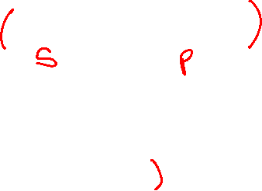
4. Elements of Categorical Logic
EXAMPLE: DOGS ARE ANIMALS (every categorical proposition has two terms)
TWO CATEGORIES/CLASSES HERE
DOGS subject term (not in the grammatical sense but in terms of primary class to be related to the second) - The subject term is a the portion of the proposition that refers to a set of persons, animals, places, or things.
ANIMALS, predicate term (the secondary class to be related to the first)
The predicate term is some quality which the subject is supposed to have.
PROPOSITIONS TYPICALLY COMPARE CATEGORIES OF THINGS OR CLASSES
15

Slide 16
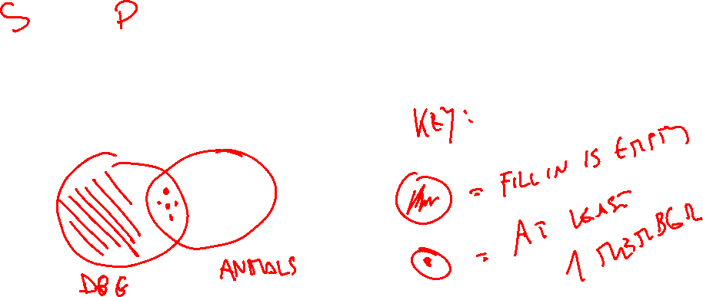
DOGS ARE ANIMALS…. (ALL) DOGS ARE ANIMALS
How the first category relates to the second, helpful means to compare classes
16

Slide 17
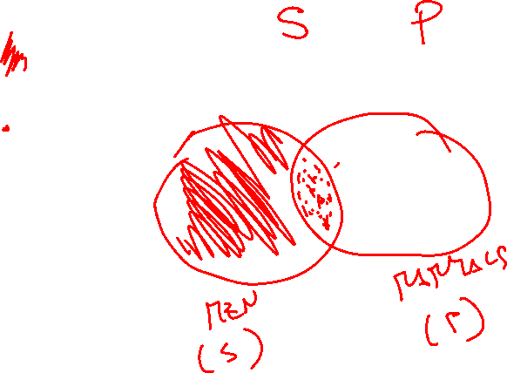
MEN ARE MAMMALS…. (ALL) MEN ARE MAMMALS
17

Slide 18
CATEGORICAL PROPOSITIONS essentially explain the relationship between two categories whether or not –for instance- they need to be excluded, included, OR whether they are universal or particular
18

Slide 19
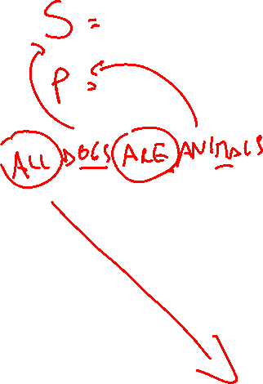
ARE (verbs in general) = COPULA (element that glues predicate and subject term together)
Yet,
We are missing how to determine the quantity (How much) the subject of one class is or is not in the predicate class and vice versa
So, we need QUANTIFIERS –all, none etc- (the final element of categorical logic which take us to standard categorical propositions…)
19

Slide 20
FOUR BASIC ELEMENTS IN CATEGORICAL LOGIC
SUBJECT TERM
PREDICATE TERM
COPULA
QUANTIFIERS
20

Slide 21
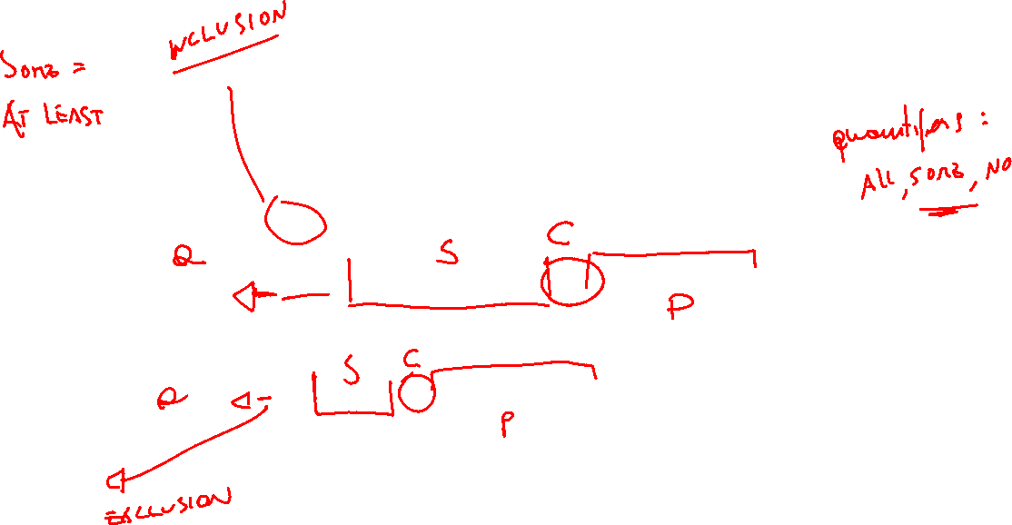
QUICK EXERCISE –individuate subject term, predicate term, copula and quantifier
All mice are rodents.
Some basketball players are seven feet tall.
A few scholars are good athletes.
No sailors are bad swimmers.
Most snakes are harmless.
21

Slide 22
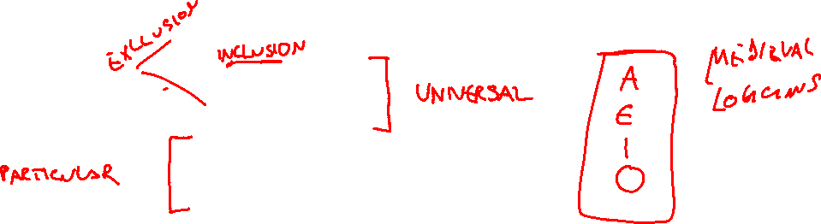
STANDARD FORMS CATEGORICAL PROPOSITIONS
Since, categorical logic asserts that either all or parts of a class denoted by the subject term is included or excluded from the class denoted by the predicate term we have 4 basic categorical propositions:
1. All S are P
2. No S are P
3. Some S are P
4. Some S are not P
22

Slide 23
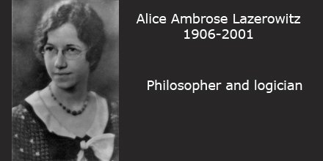

23

Slide 24
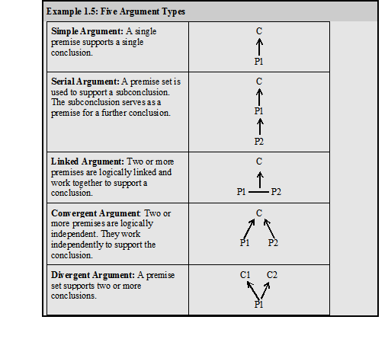
5. EXERCISES – diagramming arguments
RECALL
24

Slide 25
Fine wine can only be produced by very labour intensive methods. This means that the best wines will always be expensive. And this in turn means that wine appreciation will always be the preserve of the well-heeled.
25

Slide 26
(1) Fine wine can only be produced by very labour intensive methods. This means that (2) the best wines will always be expensive. And this in turn means that (3) wine appreciation will always be the preserve of the well-heeled.
26

Slide 27
(1) ↓ (2) ↓ (3)
27

Slide 28
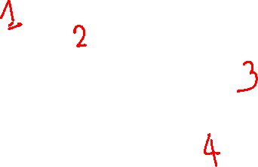
Riots broke out after the last elections in Iran, as it was evident that the results had been tampered with. The riots showed that the people of Iran were fed up with the totalitarian regime they lived under, and this in turn made the government rethink where they went wrong in addressing the people's needs.
28

Slide 29






Riots broke out after the last elections in Iran, as (2) it was evident that the results had been tampered with. The riots showed that (3) the people of Iran were fed up with the totalitarian regime they lived under, and this in turn made (4) the government rethink where they went wrong in addressing the people's needs.
29

Slide 30
(2) ↓ (1) ↓ (3) ↓ (4)
30

Slide 31
You should support Barcelona FC and not Real Madrid when they play each other in El Clasico. This is because El Clasico is first and foremost a battle of political ideologies rather than a mere sporting event, and Barcelona has the better ideology. You see, during much of the 20th century the dictator Franco used his political power to support Real Madrid and suppress Barcelona. For example, he banned Barcelona fans from attending certain matches, and he intervened to ensure that Real Madrid signed the best players. Thus, Real Madrid came to stand for the fascism and cultural homogenization that Franco enforced on Spain whereas Barcelona FC came to stand for socialism and cultural diversity. And we ought to favour the latter values over the former. In any case, Barcelona play more attractive football than Real Madrid
31

Slide 32
(1)You should support Barcelona FC and not Real Madrid when they play each other in El Clasico. This is because (2) El Clasico is first and foremost a battle of political ideologies rather than a mere sporting event, and (3) Barcelona has the better ideology. You see, (4) during much of the 20th century the dictator Franco used his political power to support Real Madrid and suppress Barcelona. For example, (5) he banned Barcelona fans from attending certain matches, and (6) he intervened to ensure that Real Madrid signed the best players. Thus, (7) Real Madrid came to stand for the fascism and cultural homogenization that Franco enforced on Spain whereas Barcelona FC came to stand for socialism and cultural diversity. And (8) we ought to favour the latter values over the former. In any case, (9) Barcelona play more attractive football than Real Madrid
32

Slide 33
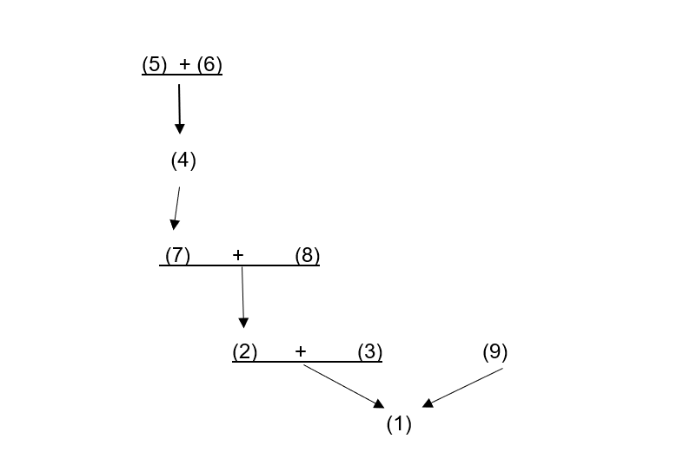
33

